Slide 1


SECEC - ESSSE
2019 Intra-European
Travelling Fellowship
Enrico Bellato
Ilker Eren
Notes:
Before start; We would like to thank the president, executive and education committees and all members of SECEC for supporting our fellowship.
Its been a huge privilege for us.

Slide 2
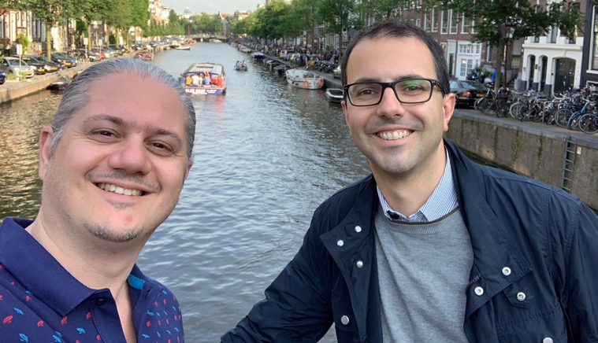
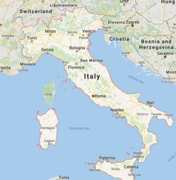
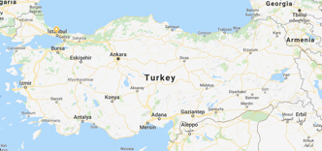


About us...
*
*
Ilker Eren, MD
Koc University,
Istanbul, Turkey
Enrico Bellato, MD
University of Turin,
Turin, Italy
Notes:
Enrico is from University of Turin, Italy. And i am from Koc University, Istanbul, Turkey.

Slide 3
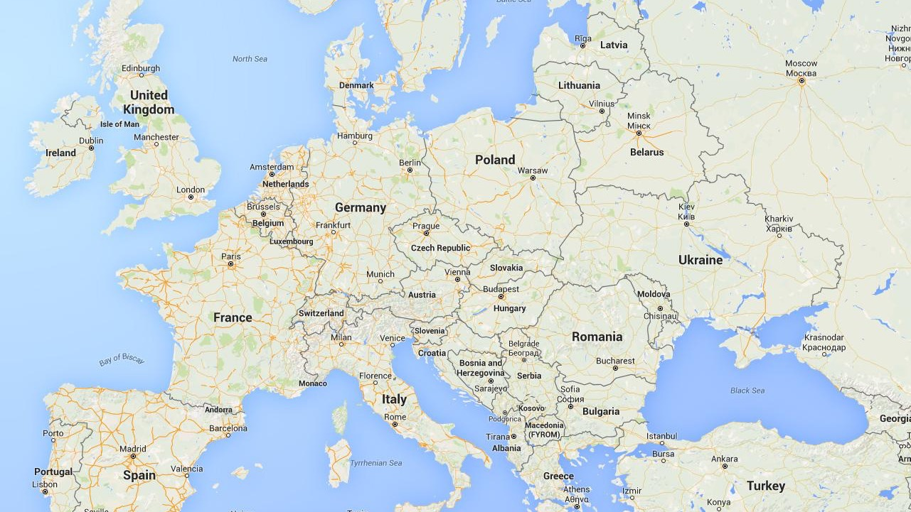
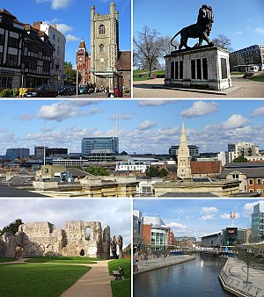
Reading, UK
1

Slide 4
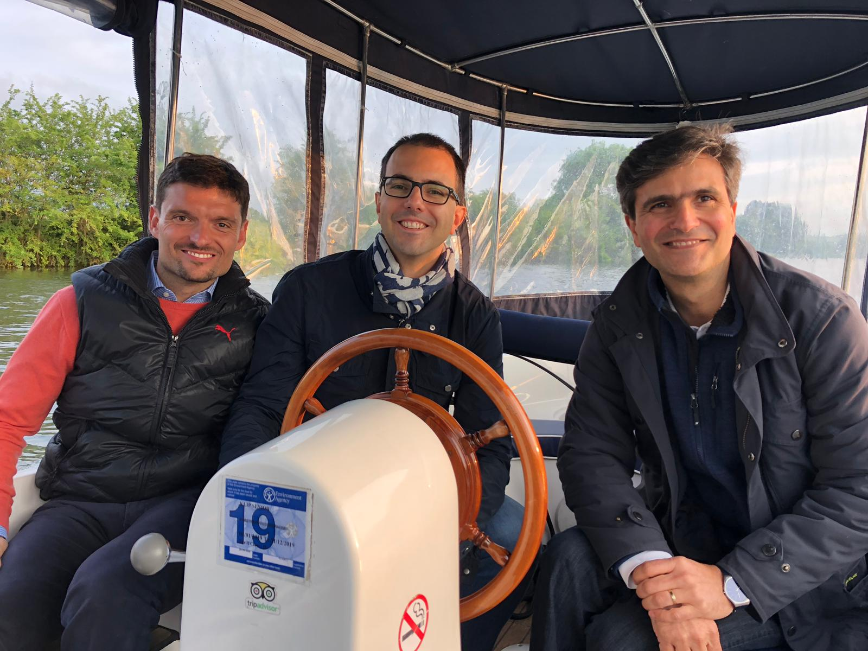

Slide 5
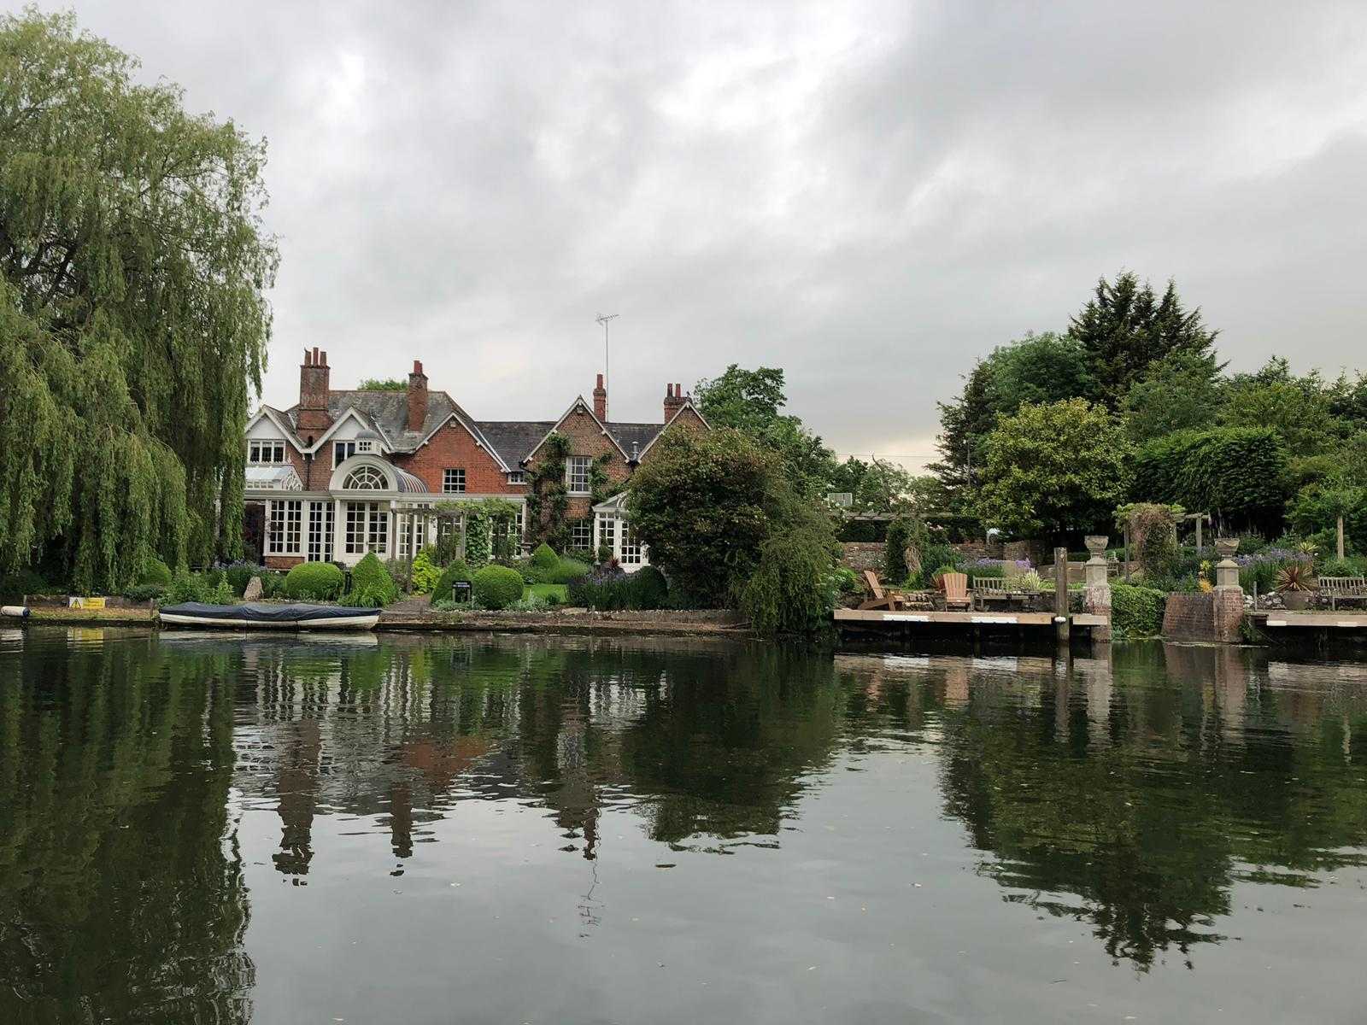
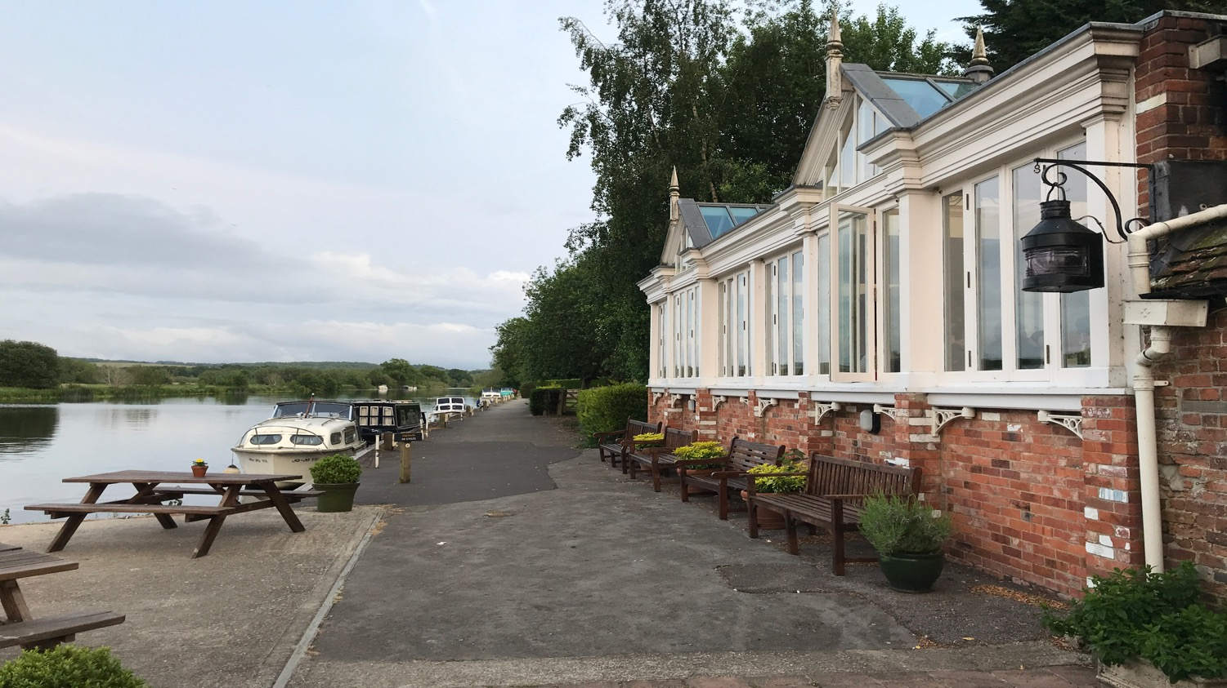

Slide 6
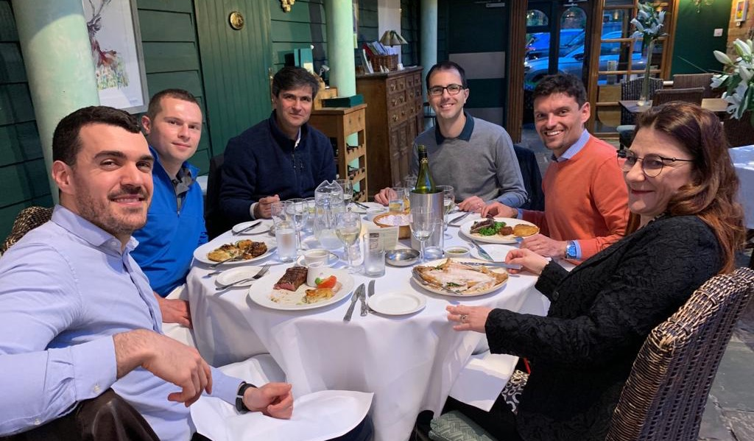

Slide 7
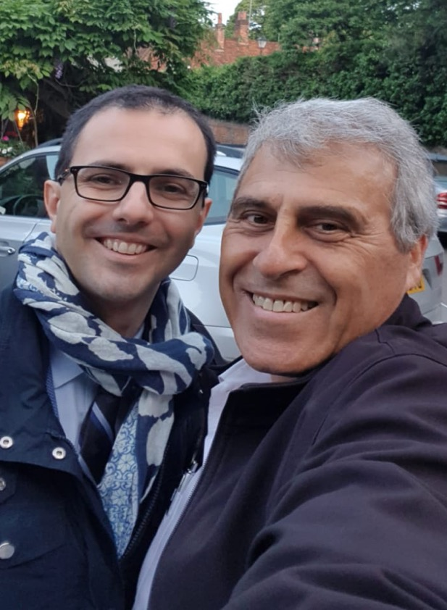
Ofer Levy

Slide 8
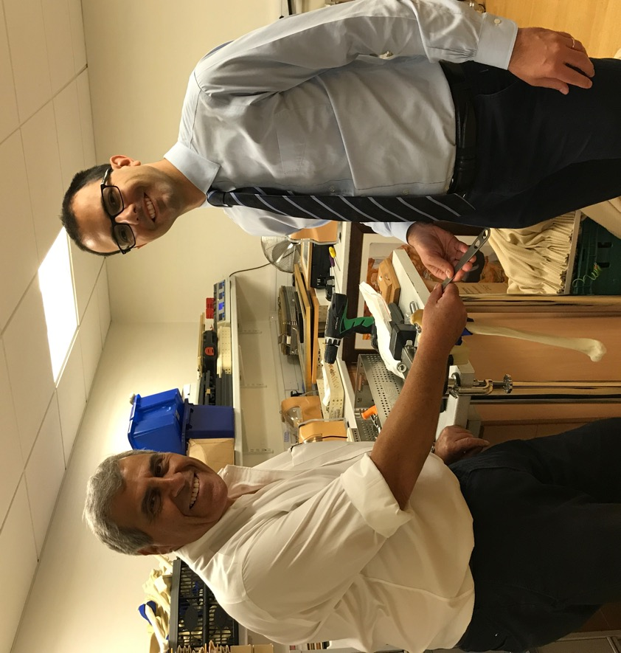
Notes:
.

Slide 9
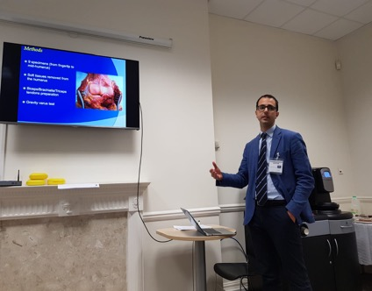
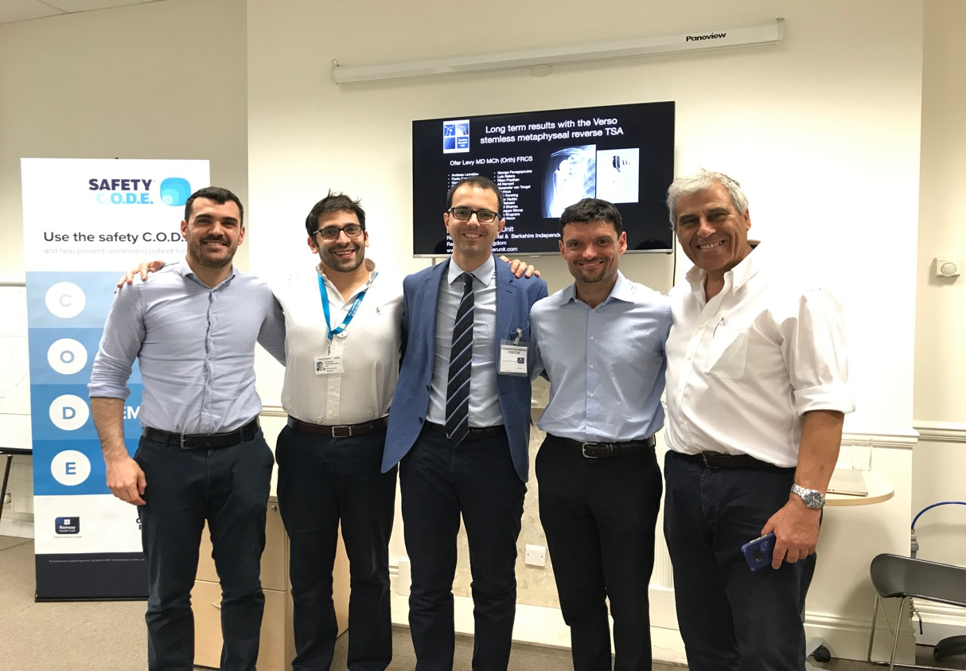

Slide 10
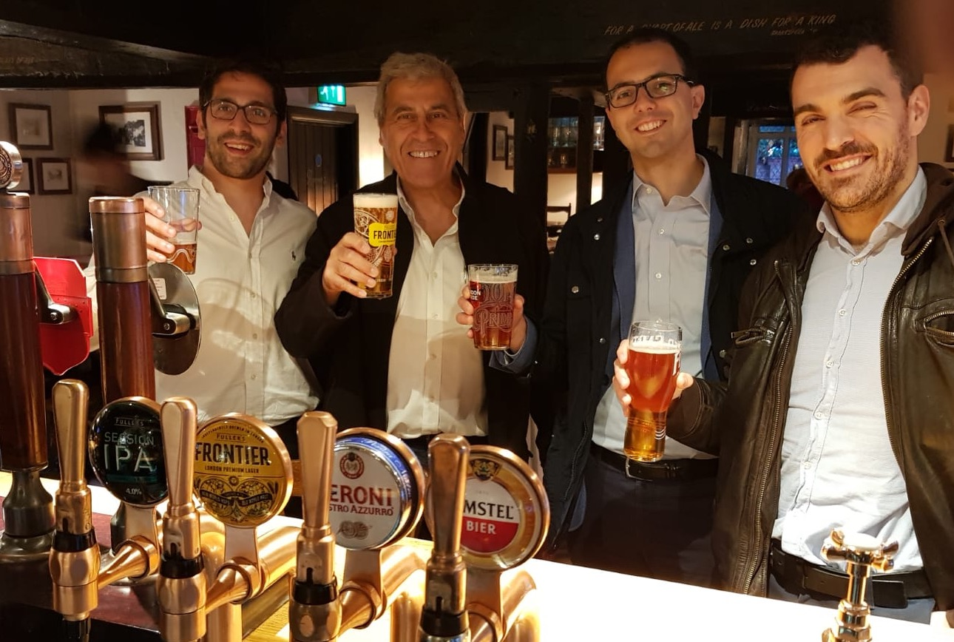

Slide 11
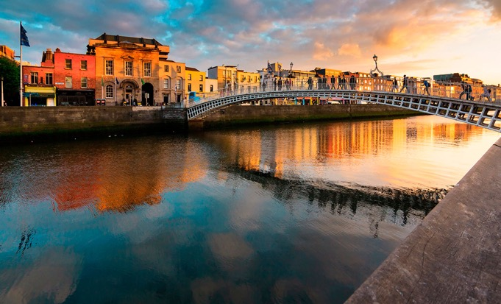
Dublin, Ireland
2

Slide 12
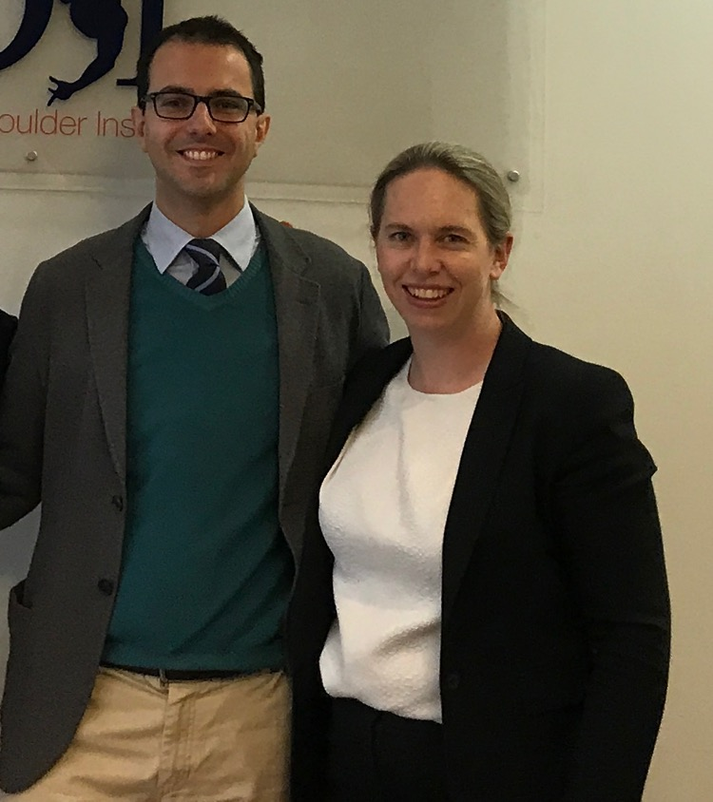
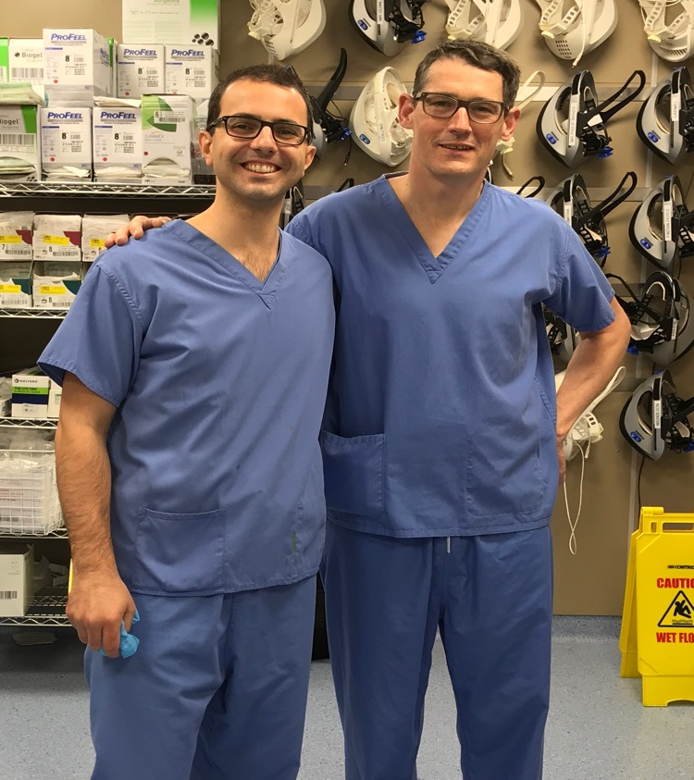
Ruth Delaney
Hannan Mullet

Slide 13
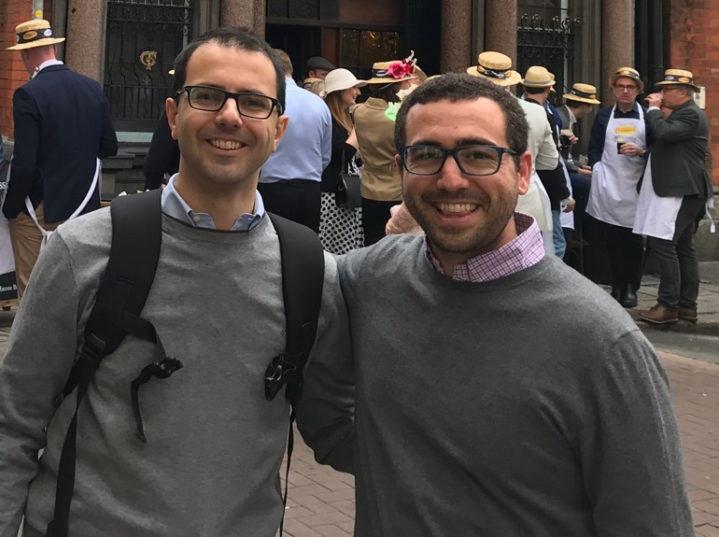
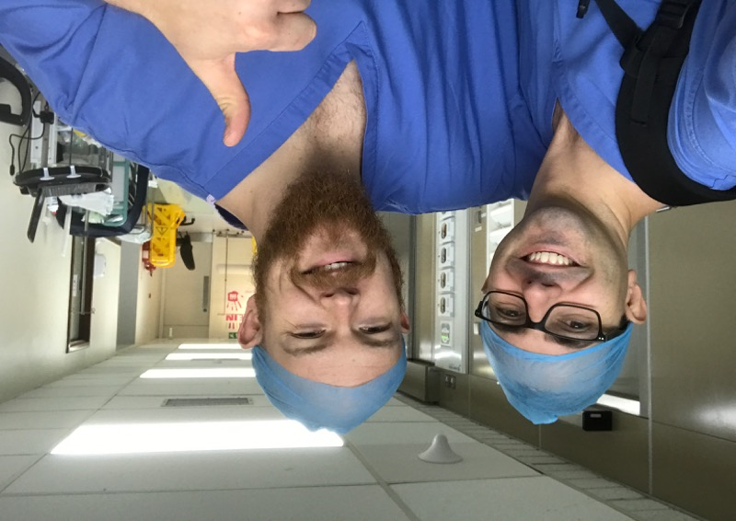

Slide 14
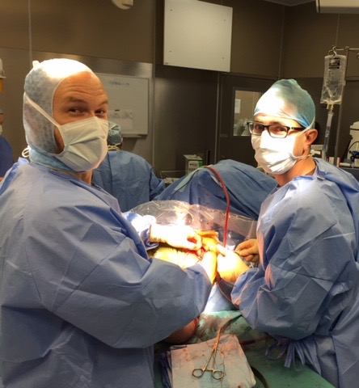
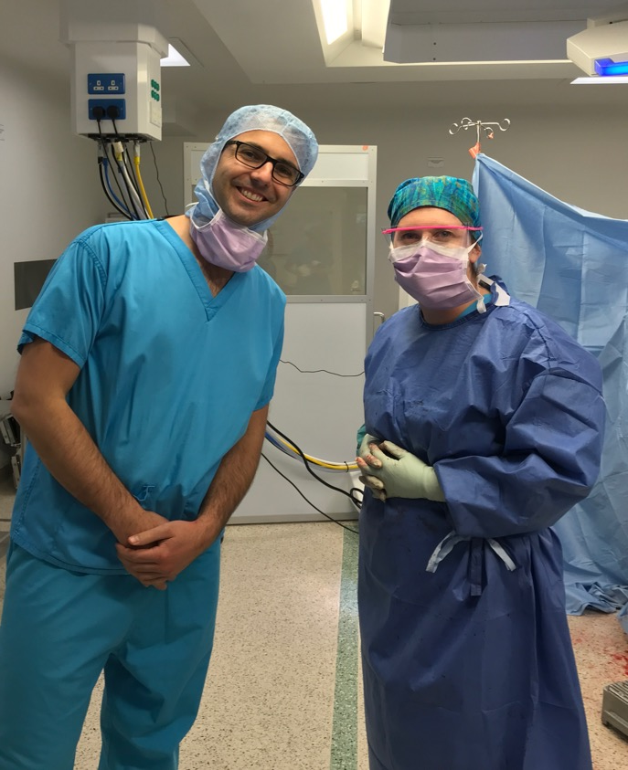

Slide 15
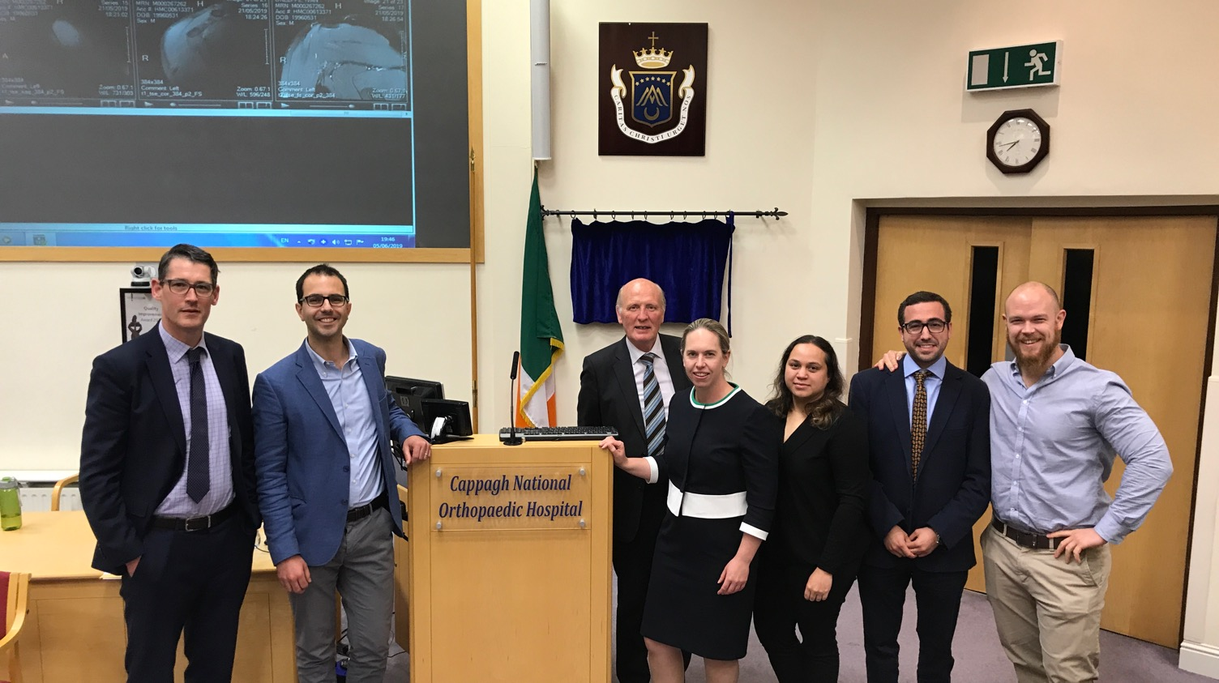

Slide 16
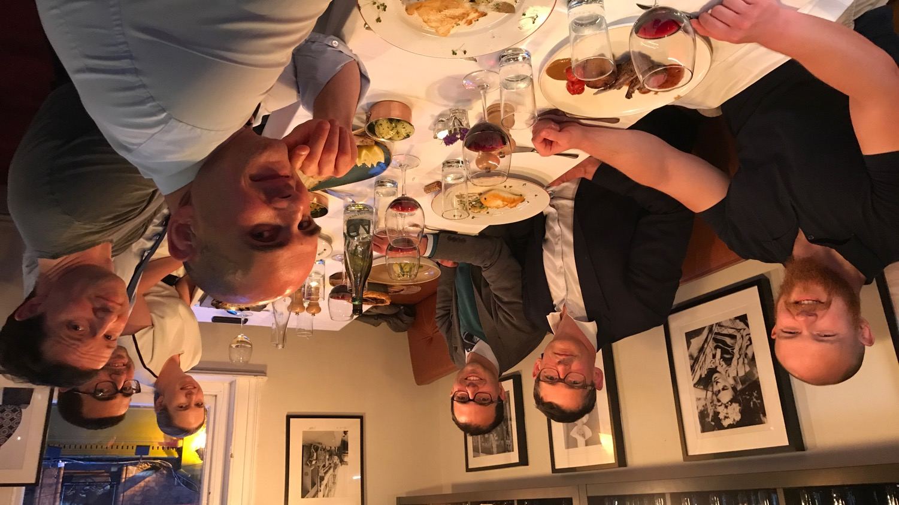

Slide 17
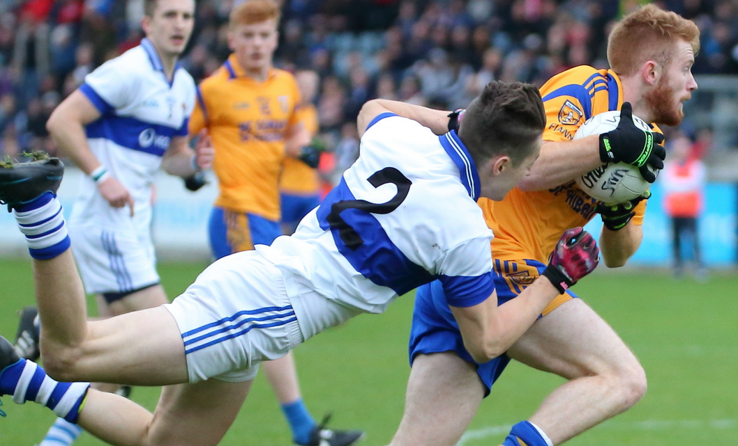

Slide 18
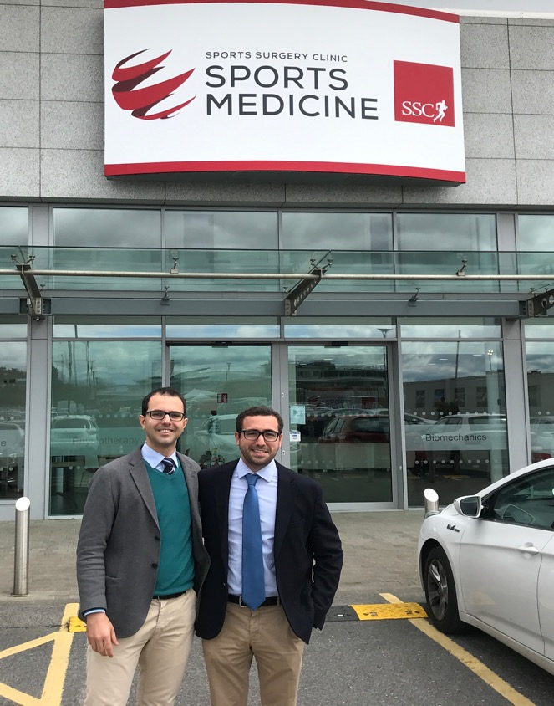
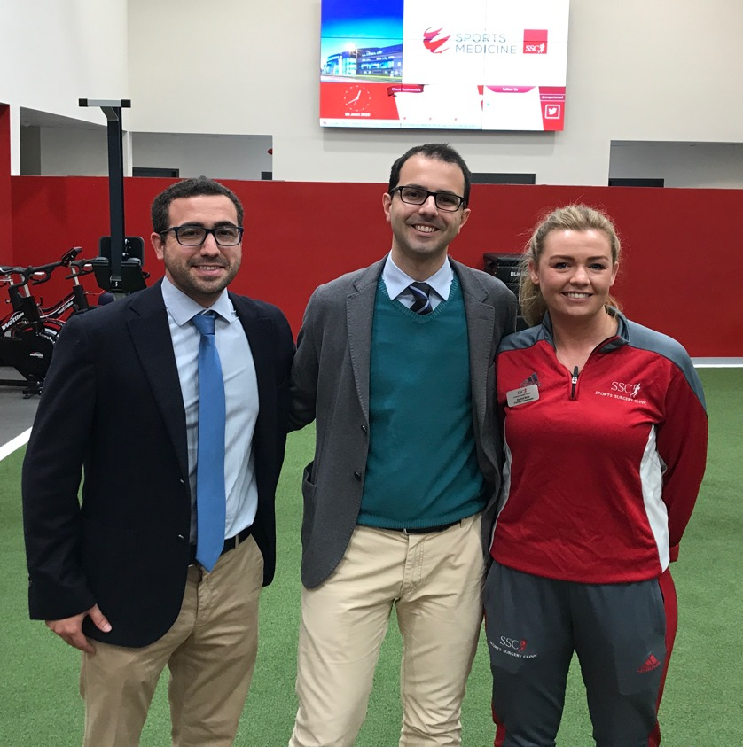

Slide 19
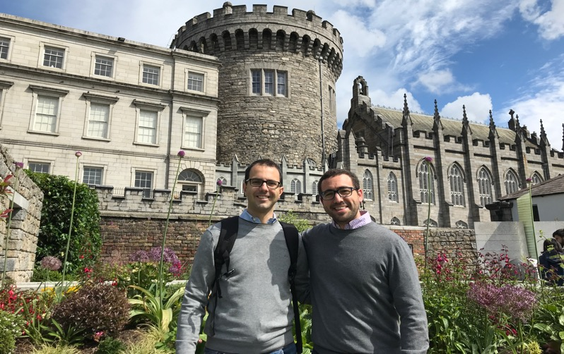
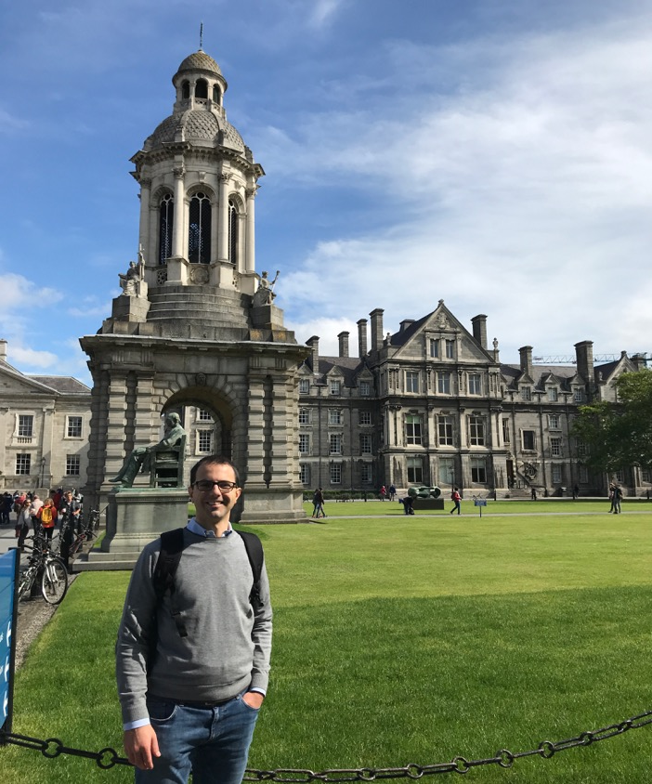
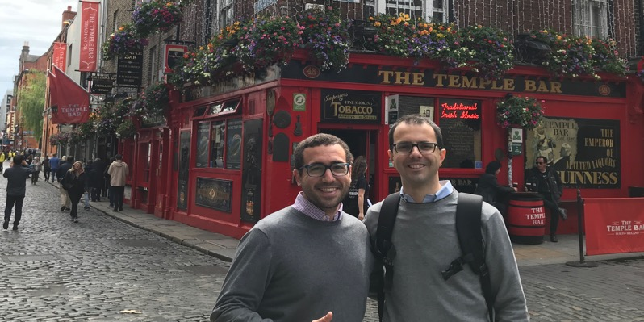
NO RAIN!!!

Slide 20
Istanbul, Turkey
3

Slide 21
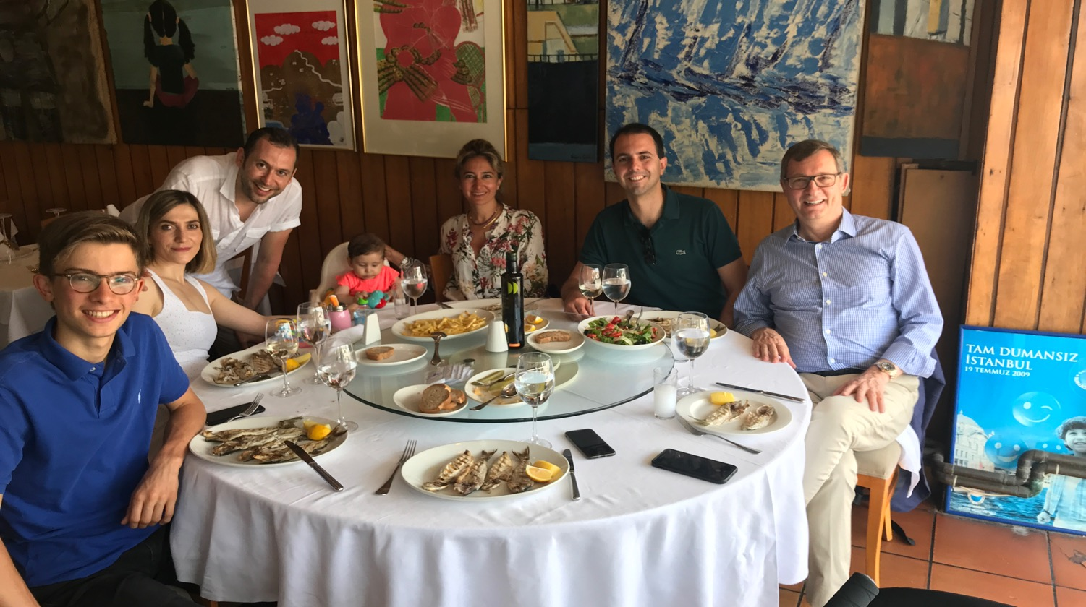
Mehmet Demirhan

Slide 22
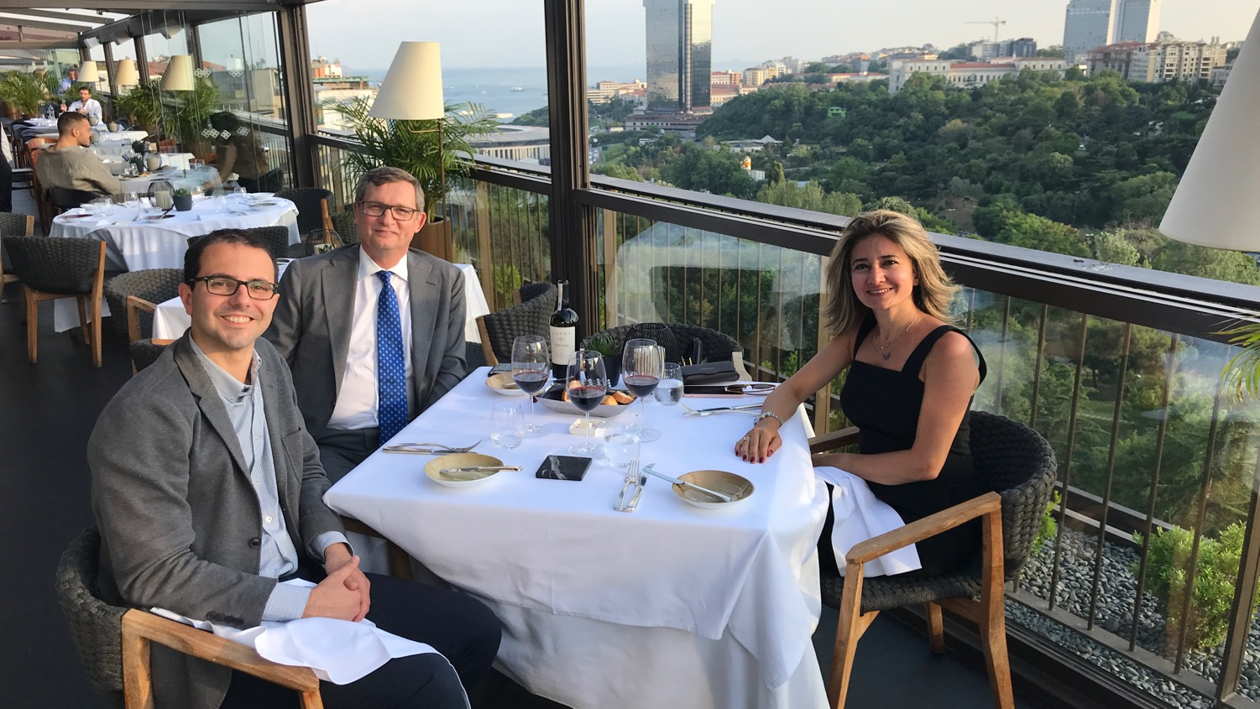

Slide 23
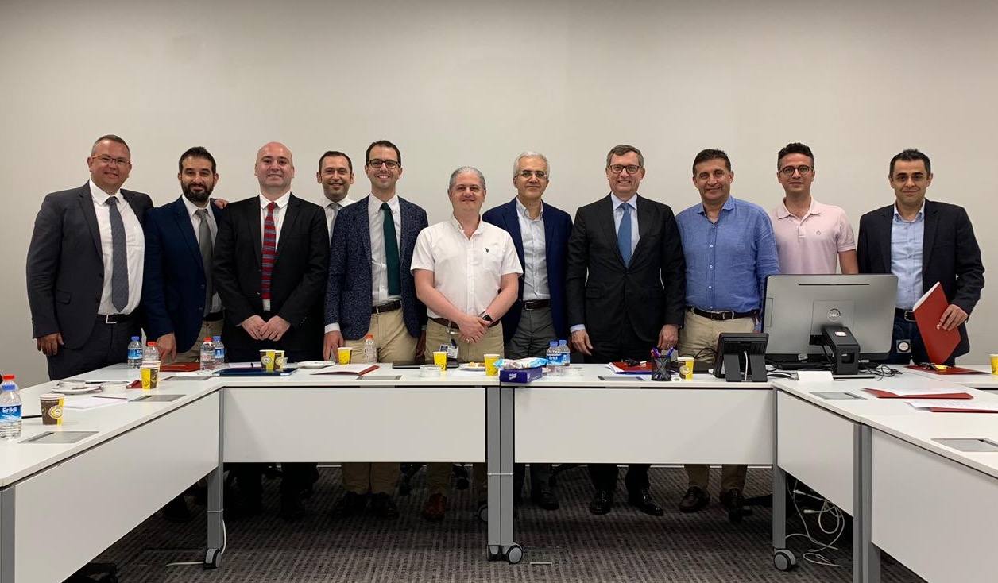
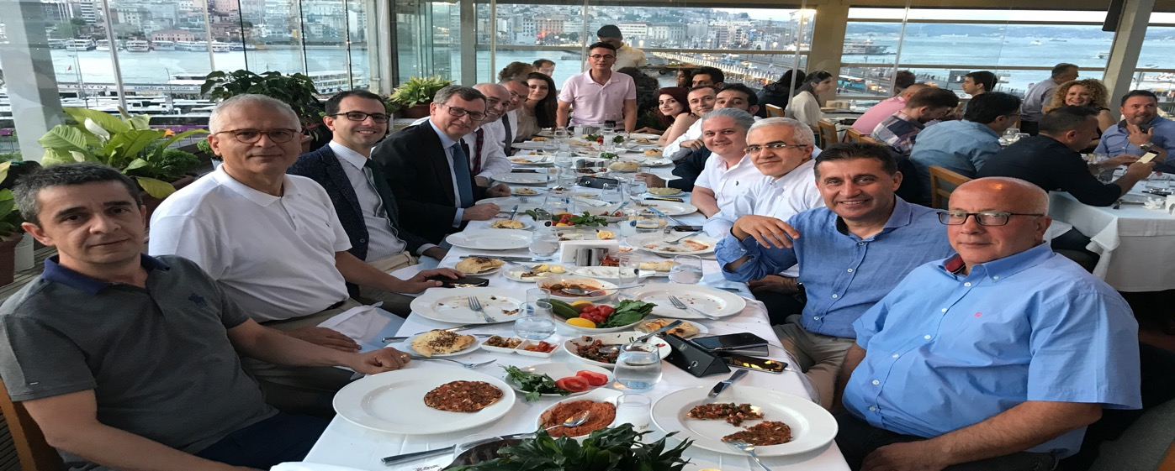

Slide 24
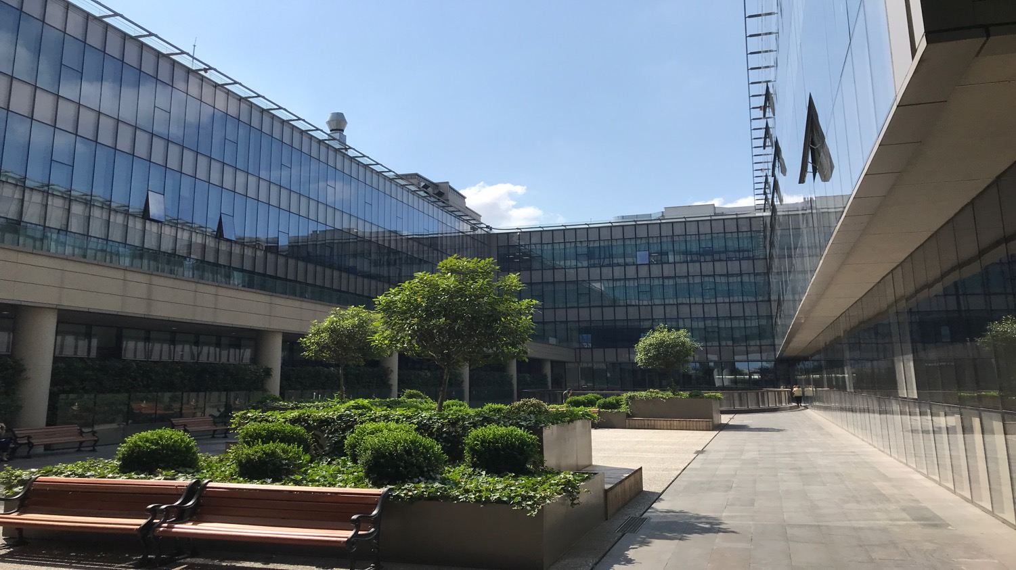

Slide 25
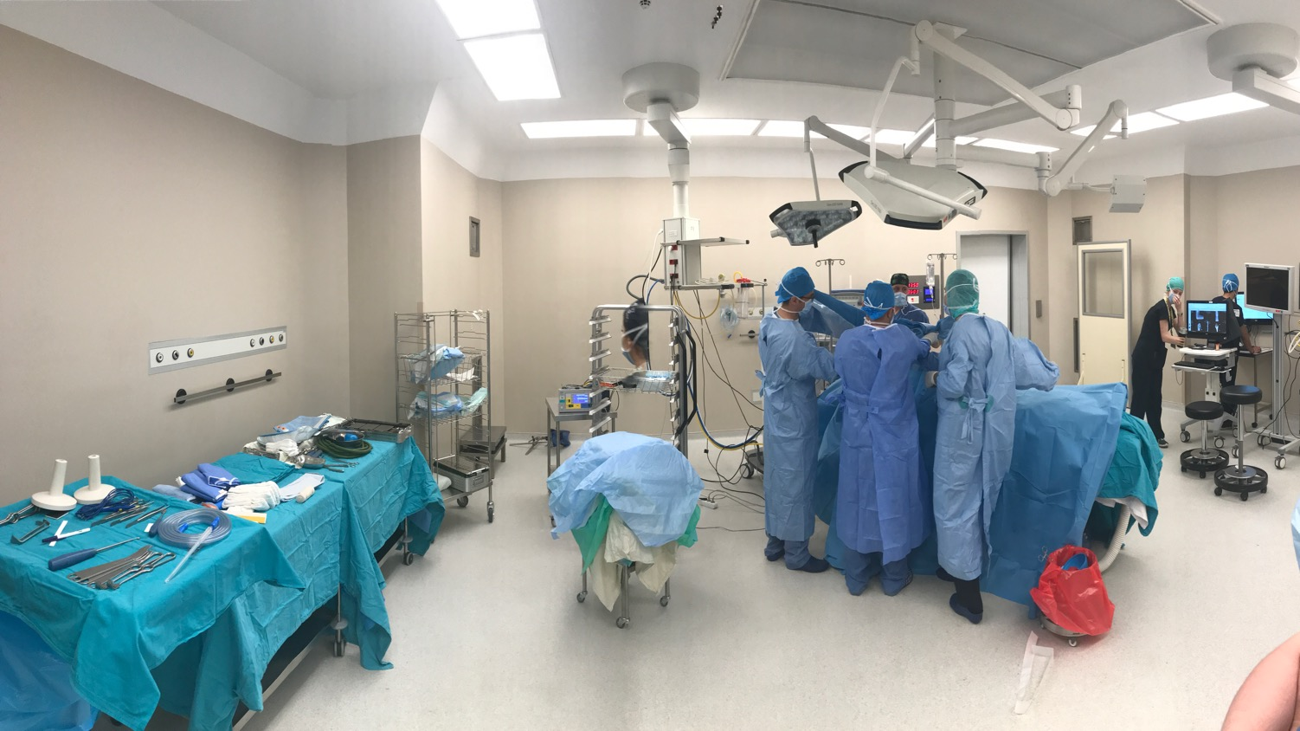
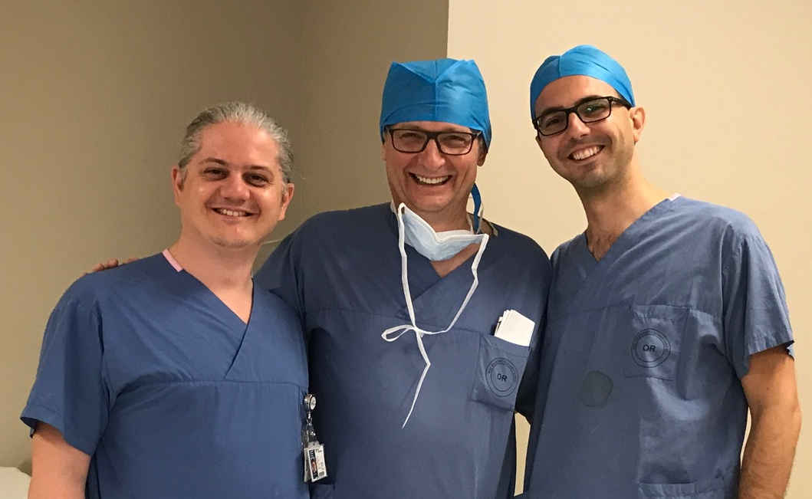

Slide 26
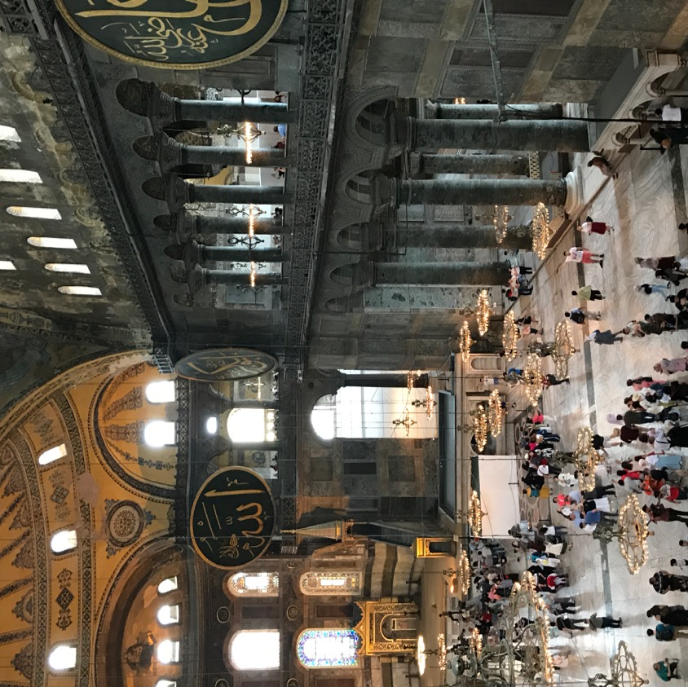
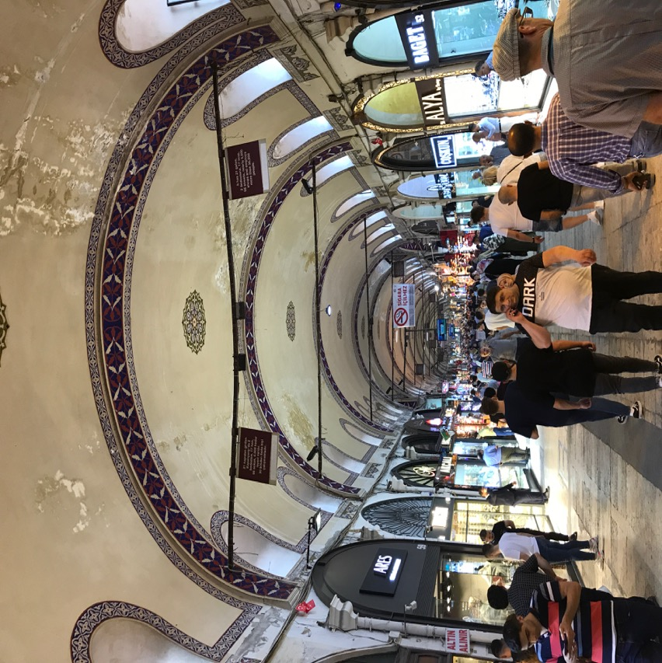

Slide 27
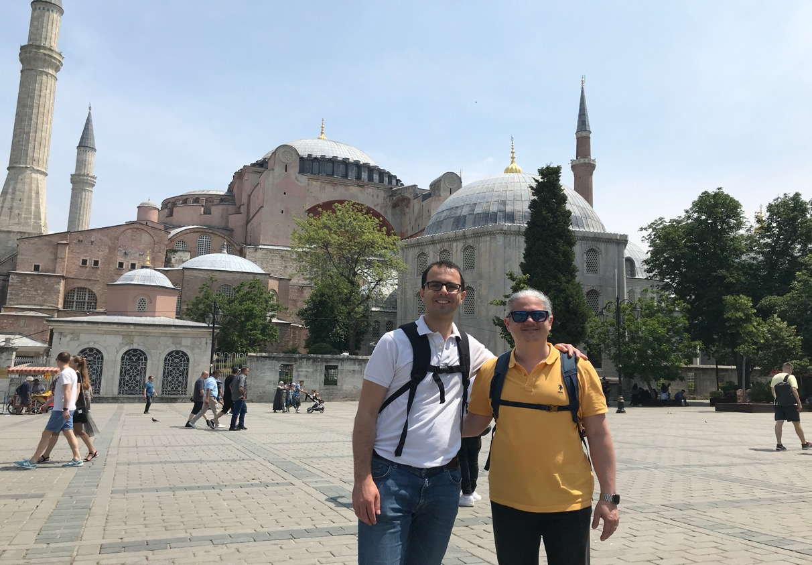

Slide 28
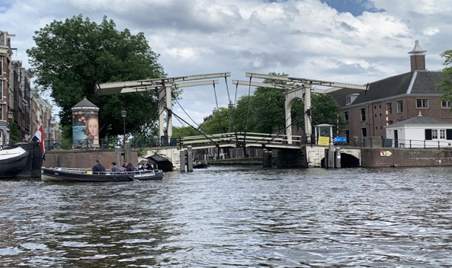
Amsterdam, Netherlands
4
Notes:
Our next destination was amsterdam

Slide 29
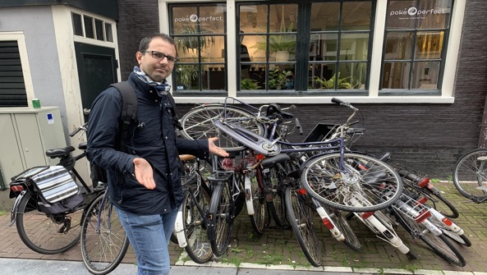
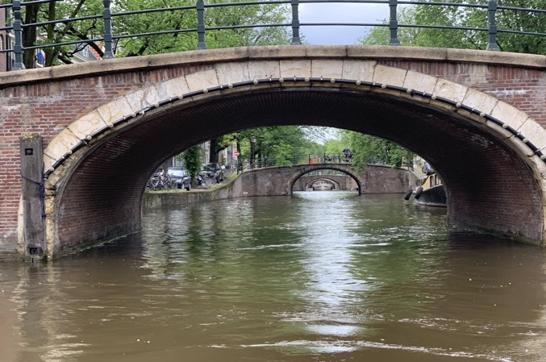
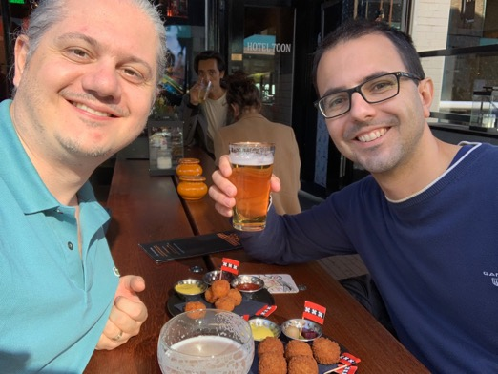
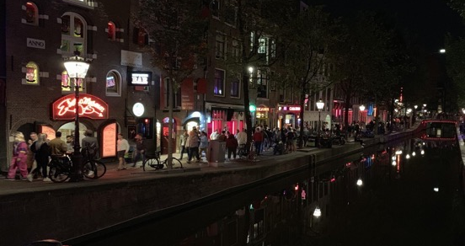

Slide 30
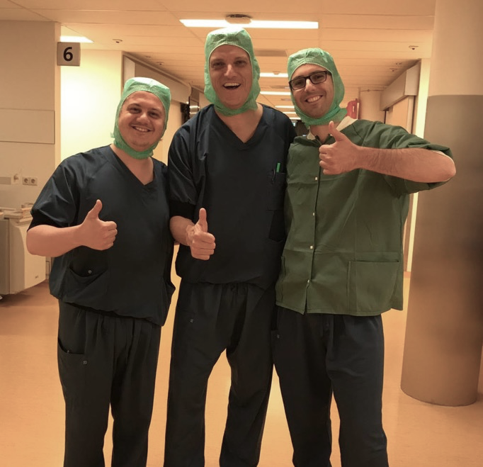
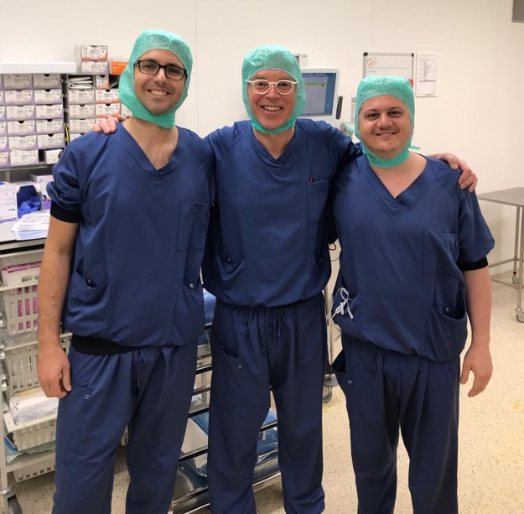
Tjarco Alta
Arthur van Noort

Slide 31
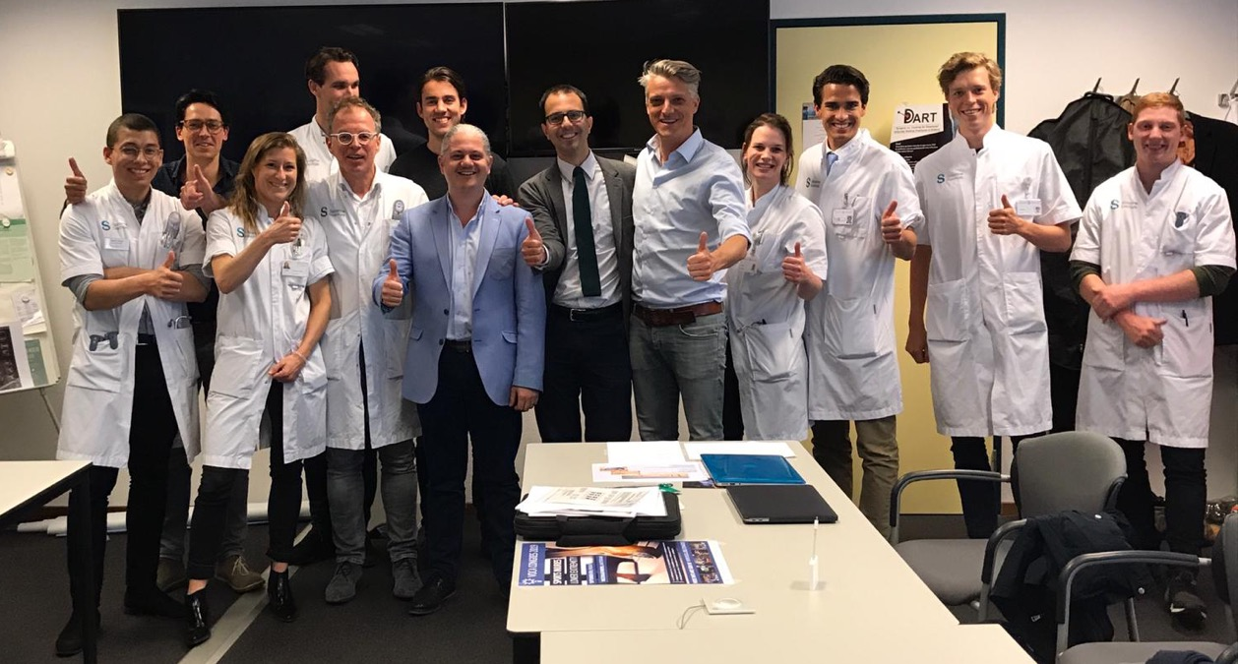
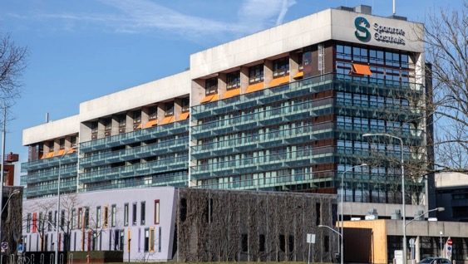
Spaarne Gasthuis, Hoofddorp

Slide 32
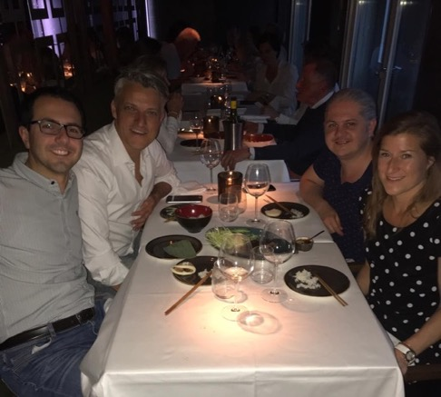
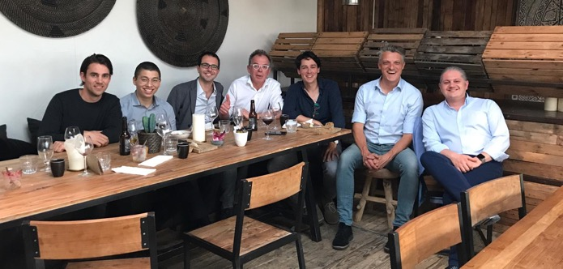


Slide 33

Geneva, Switzerland
5

Slide 34

Alexandre
Laedermann

Slide 35



Quack!

Slide 36




Slide 37








Cycling…

Slide 38
Bern, Switzerland
6

Slide 39

Matthias Zumstein

Slide 40


Slide 41


Slide 42


Slide 43

Notes:
.

Slide 44


Slide 45


Slide 46
Rennes, France
7

Slide 47


Slide 48

Philippe Collin

Slide 49


Slide 50


Slide 51




Slide 52
Lyon, France
8

Slide 53






Slide 54



Lionel Neyton
Arnaud Godenèche

Slide 55



Slide 56



Slide 57

Antwerp, Belgium
9

Slide 58


Olivier Verborgt
Roger van Riet

Slide 59


Slide 61
Take home messages…
In UK reading can be also Reading
In Dublin it’s possible to see the sun
Be ready to walk for miles at the airport if you go to Istanbul
In Amsterdam it is not allowed to take photos of everything. You know what we mean…
Electric bikes are not just for fun. They are a “MUST” in cities with hills like Geneva.
If you want to catch a train in Bern, don’t behave like Turkish or Italian people. Be on time. Exactly on time.
To drive a car in Rennes you need to be foldable
Lyon can be hot. Like Sahara desert. Be prepared.
Make sure your wife doesn’t know how diamonds and Antwerp are related.

Slide 62



Thank You

